Slide 1
Issues about the 2nd batch HTT competitors and internal compounds
Sep 26, 2022
Zhen, Dann, Catherine, Joon, Magnus, Jessica

Slide 2
Sample similarity from Gene Expression (1st batch)
PCA in 2D for iPSC
PCA in 2D for NGN2

Slide 3
Sample similarity from Gene Expression (2nd batch raw)
PCA in 2D for iPSC
PCA in 2D for NGN2

Slide 4
Sample similarity from Gene Expression (2nd batch raw after removal of low-quality samples)
PCA in 2D for iPSC
PCA in 2D for NGN2

Slide 5
Sample similarity from Gene Expression (2nd batch raw after removal of R4)
PCA in 2D for iPSC
PCA in 2D for NGN2

Slide 6
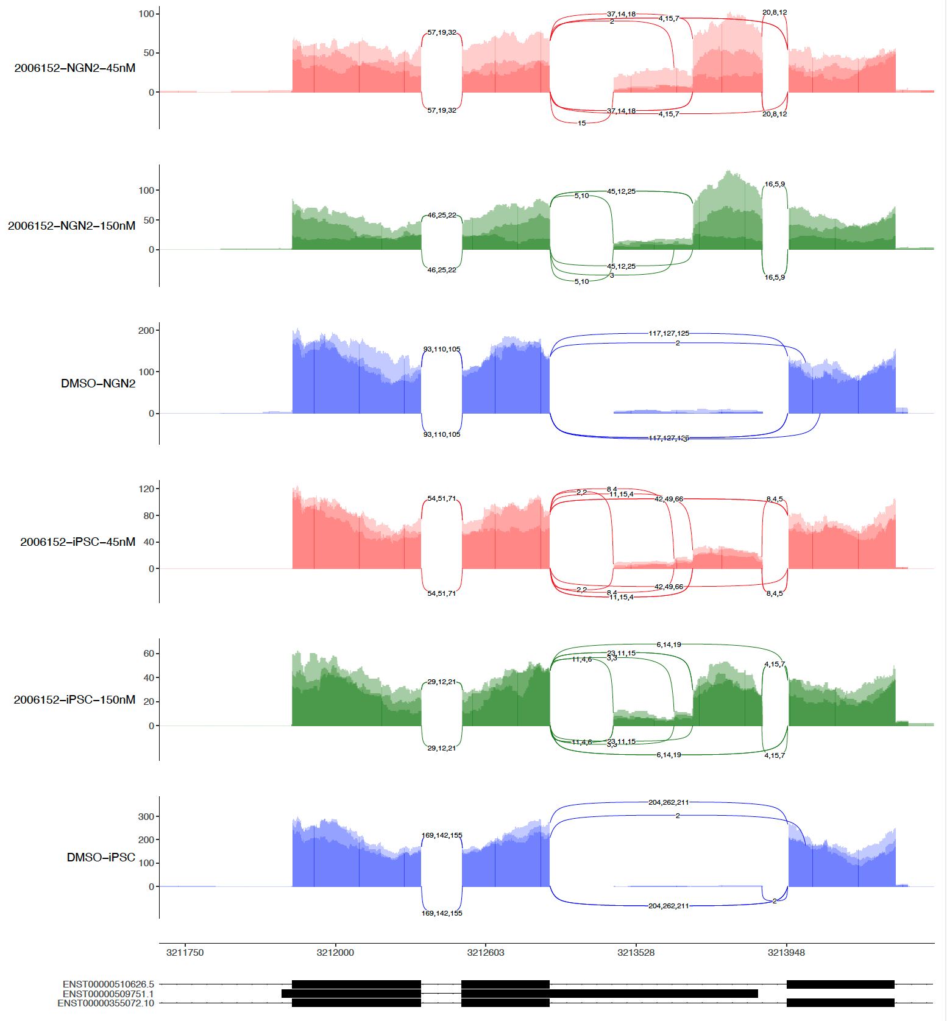
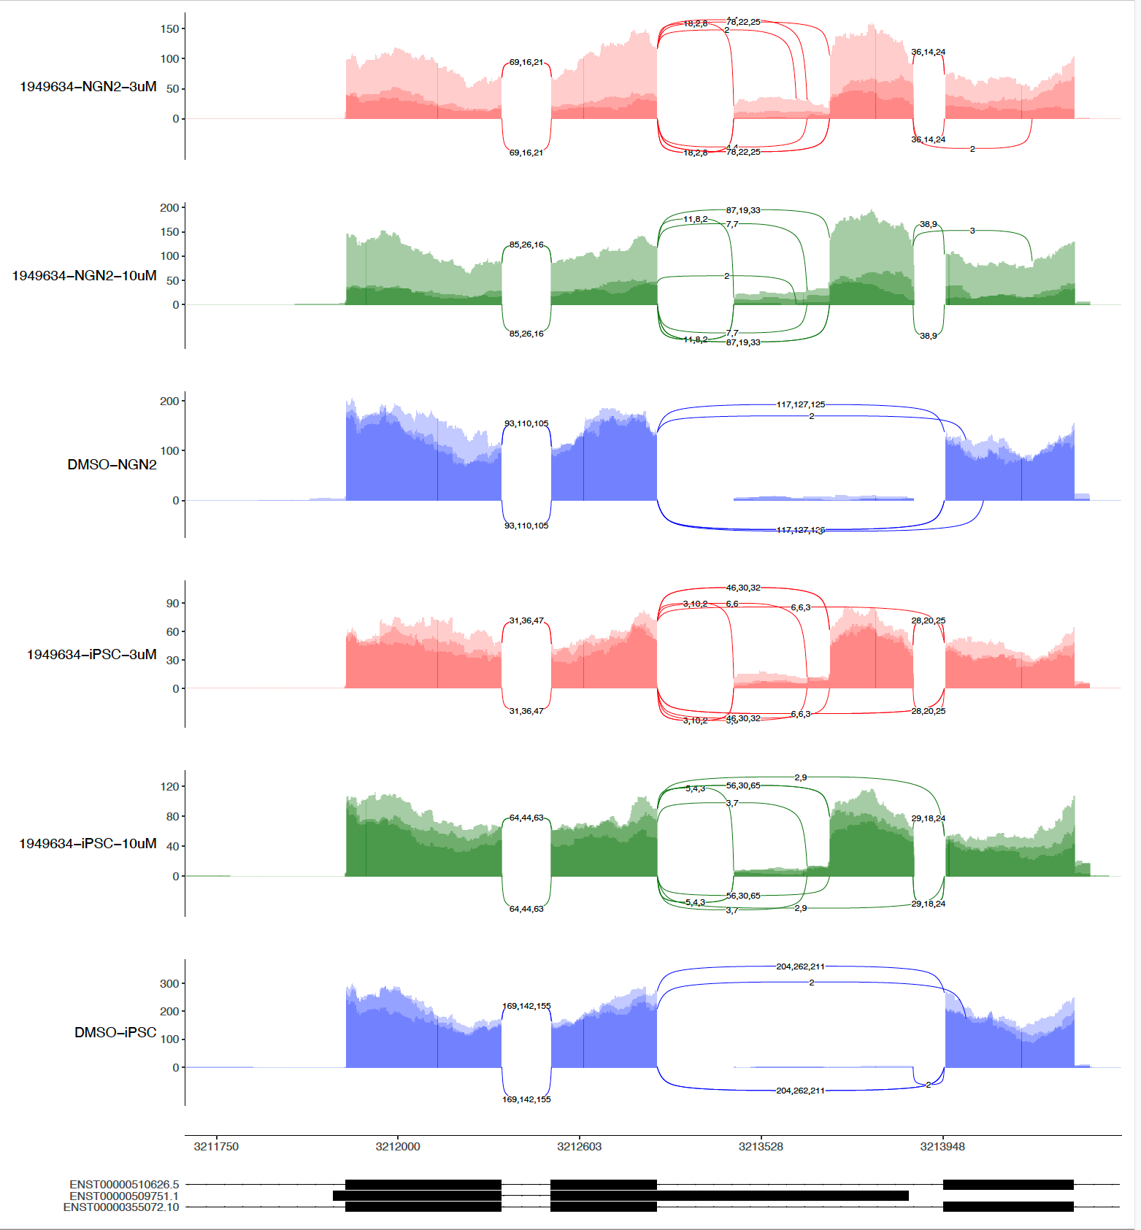
sashimi-plots: 1st 6152 and 9634

Slide 7
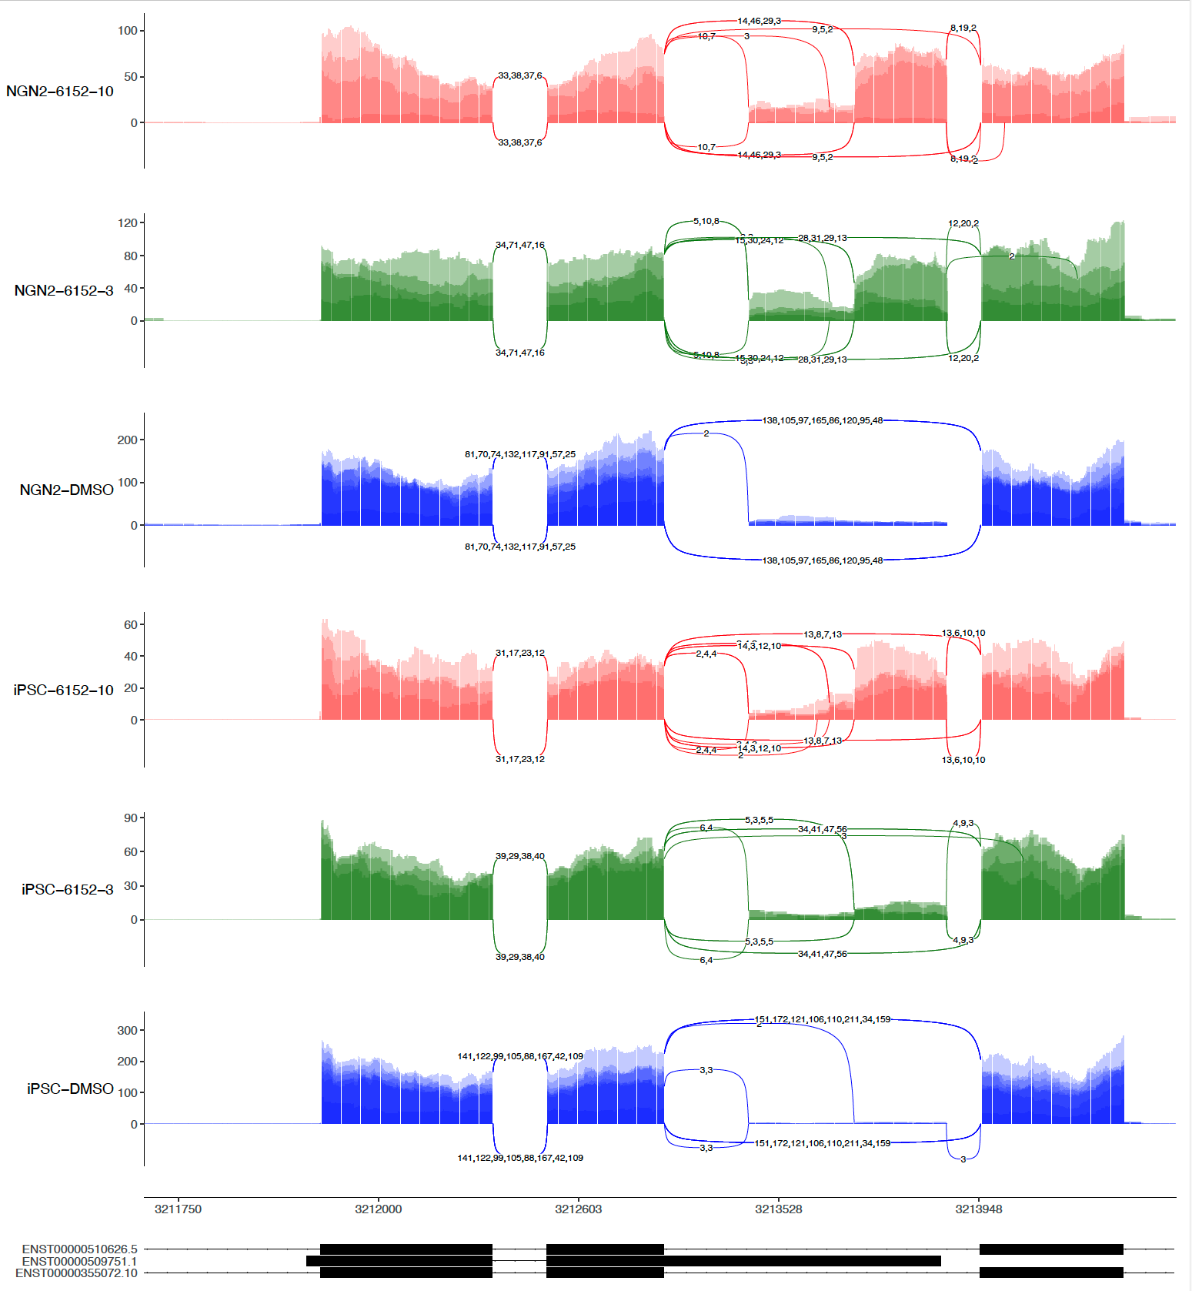
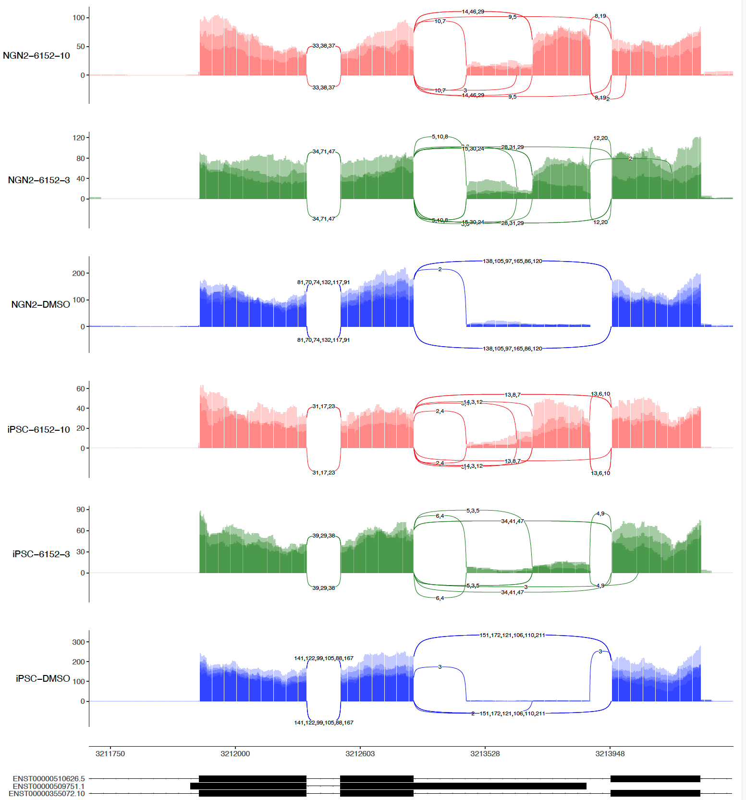
sashimi-plots: 2nd 6152
4 repeats
3 repeats (No R4)

Slide 8
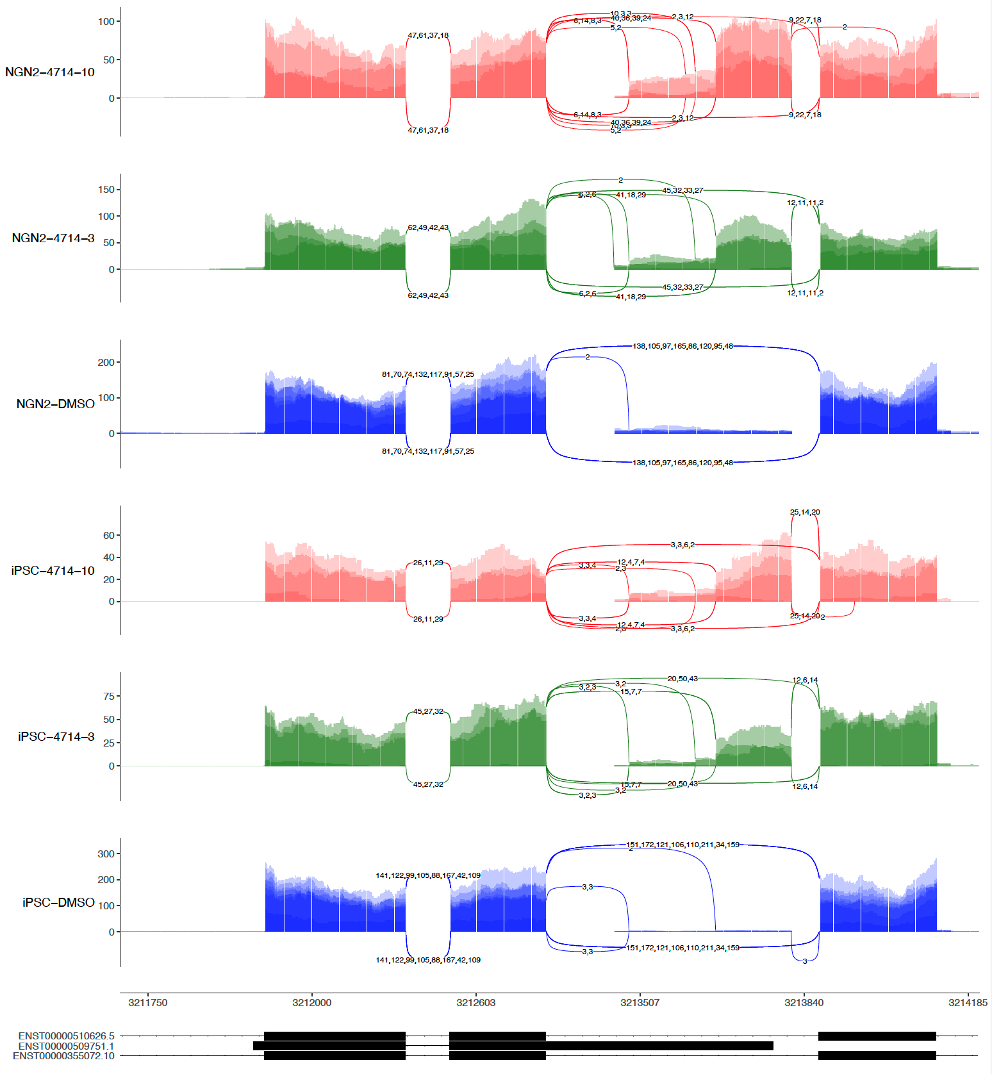
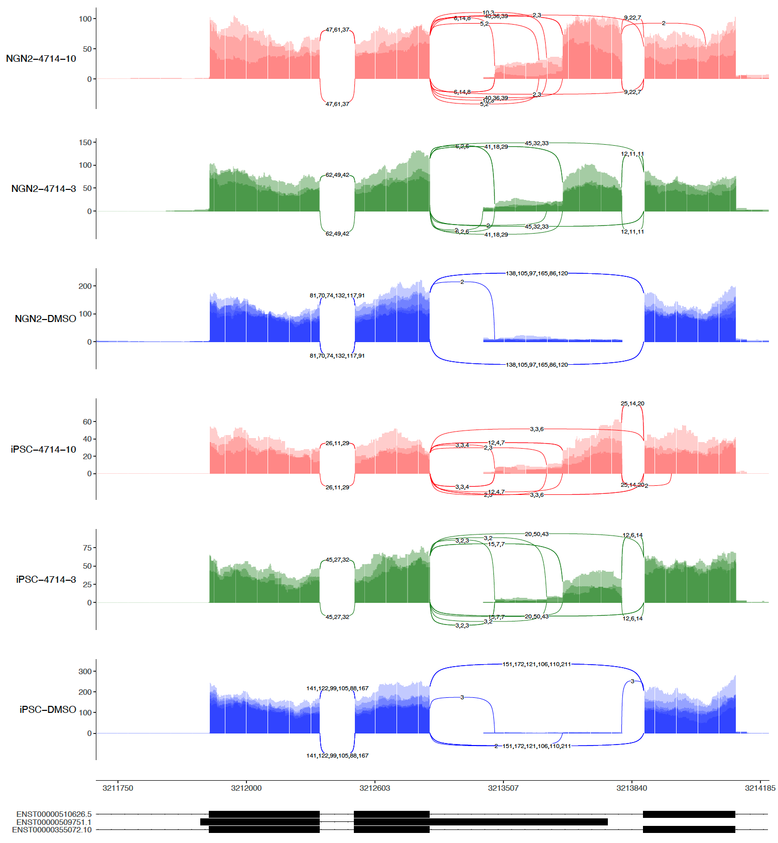
sashimi-plots: 2nd 4714
4 repeats
3 repeats (No R4)

Slide 9
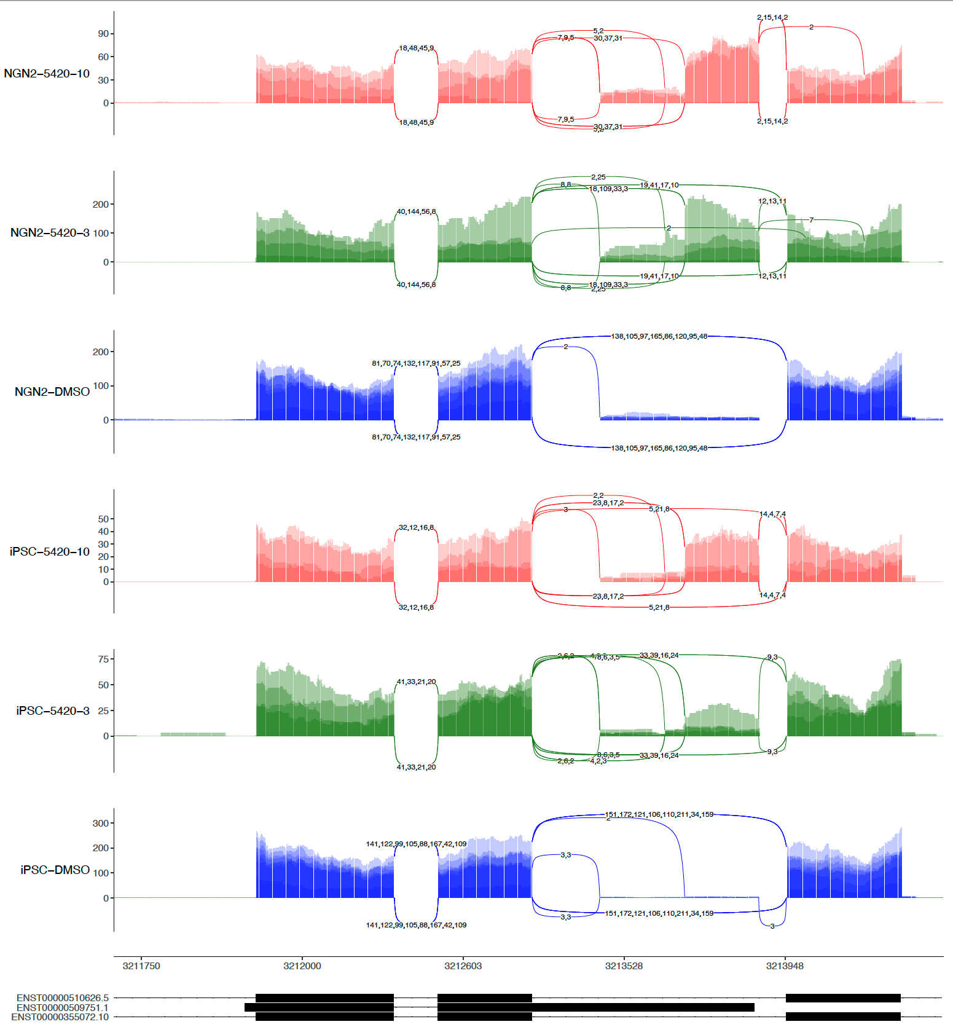
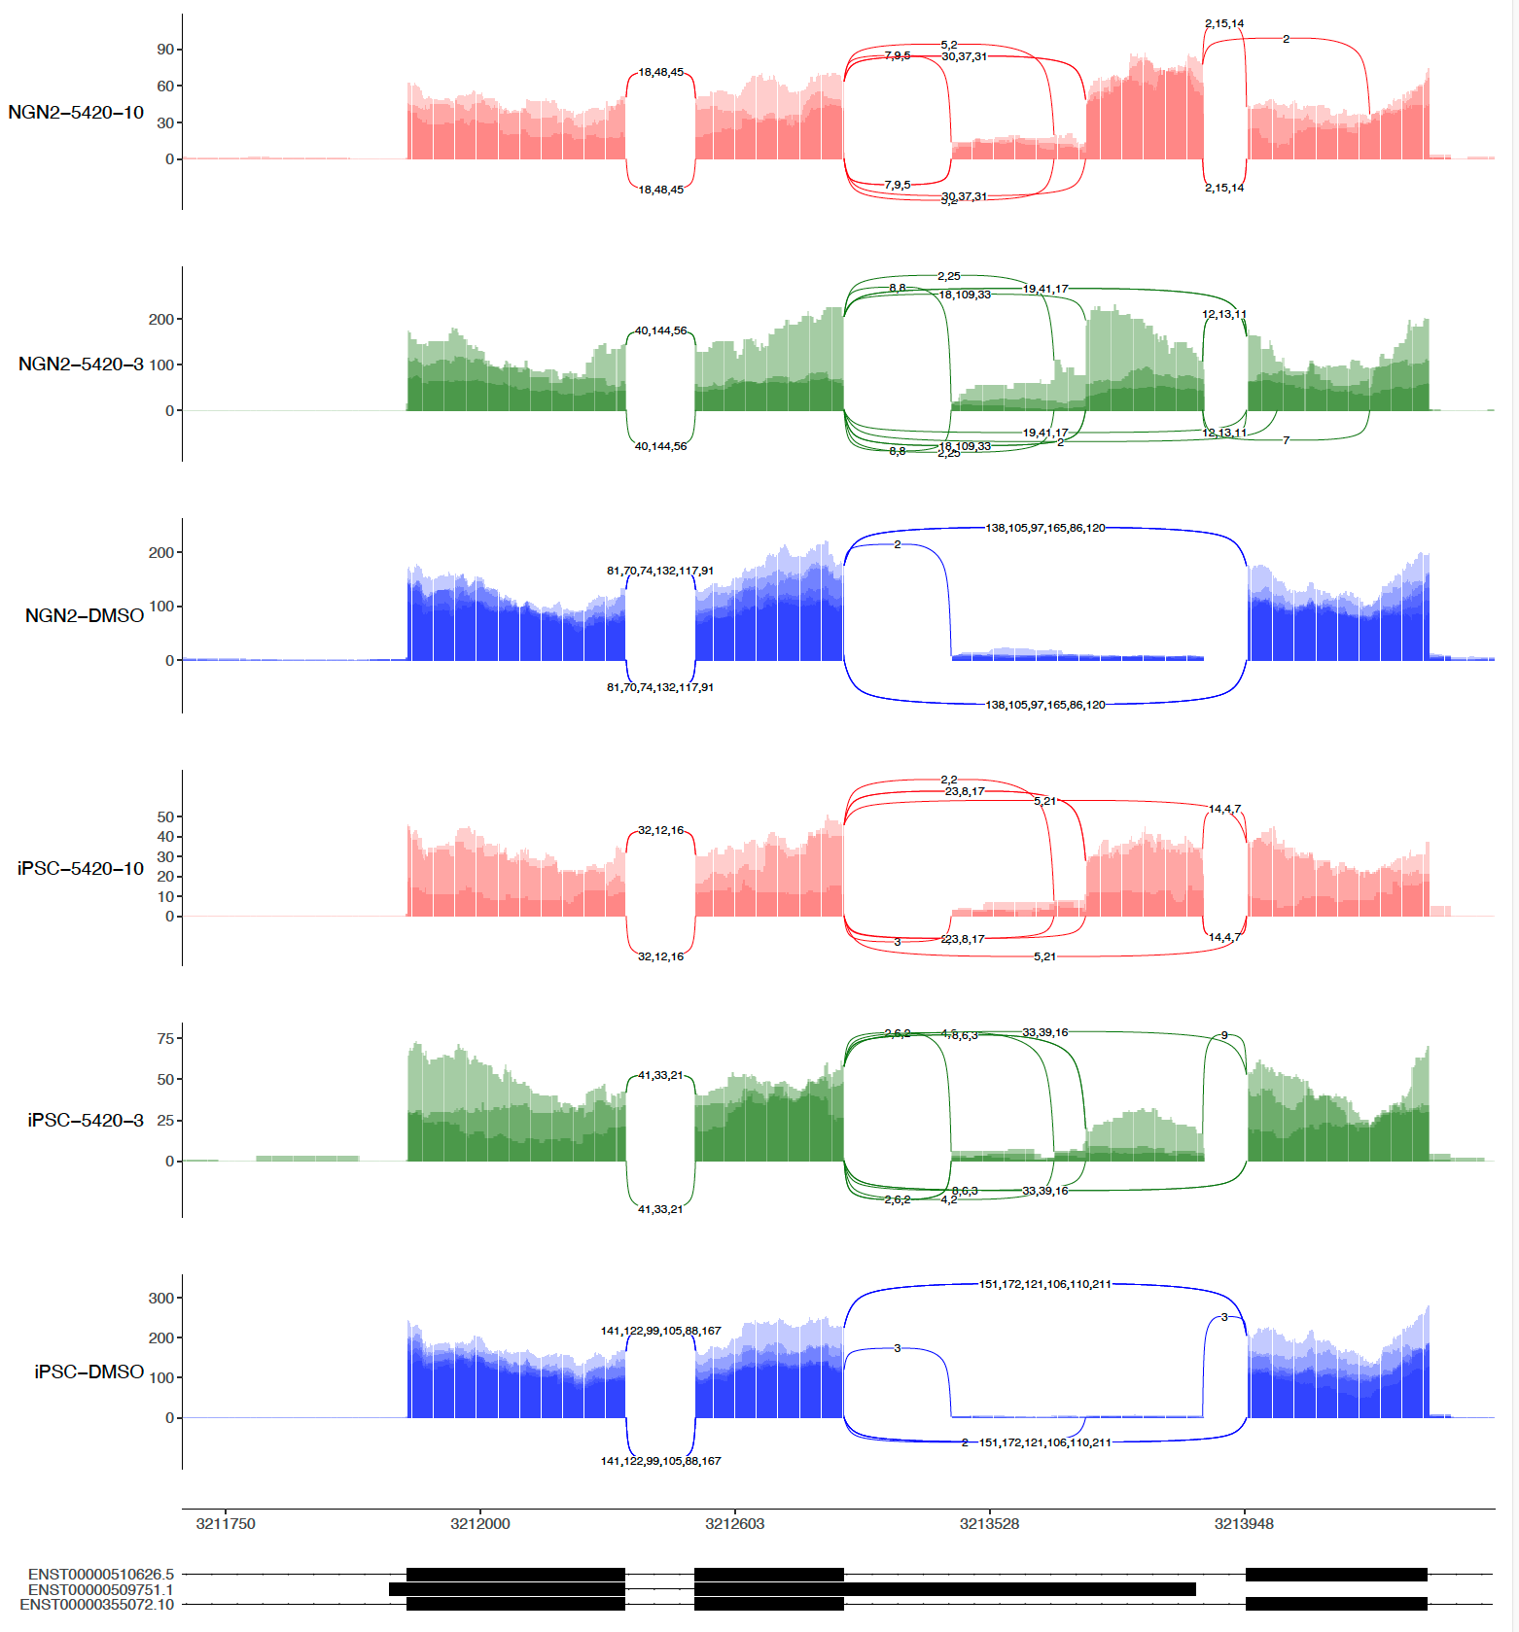
sashimi-plots: 2nd 5420
4 repeats
3 repeats (No R4)

Slide 10
sashimi-plots: 1st 6152 and 2nd 6152

Slide 11
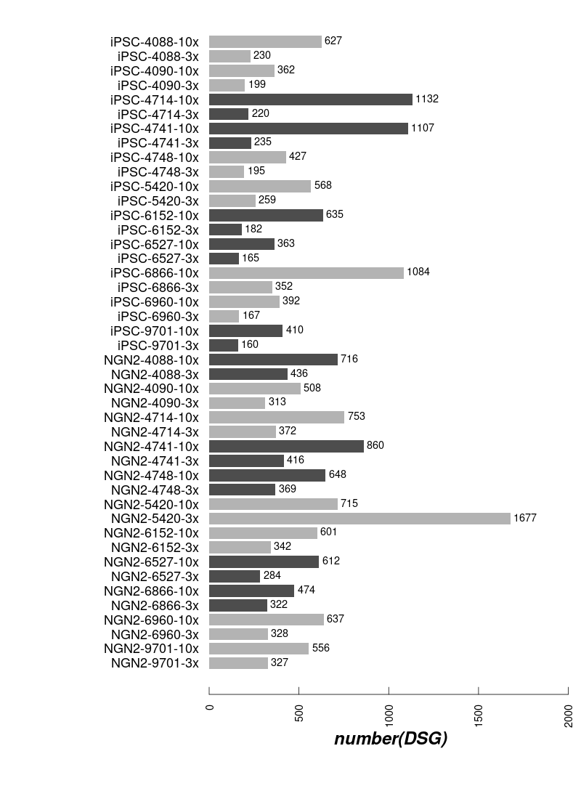
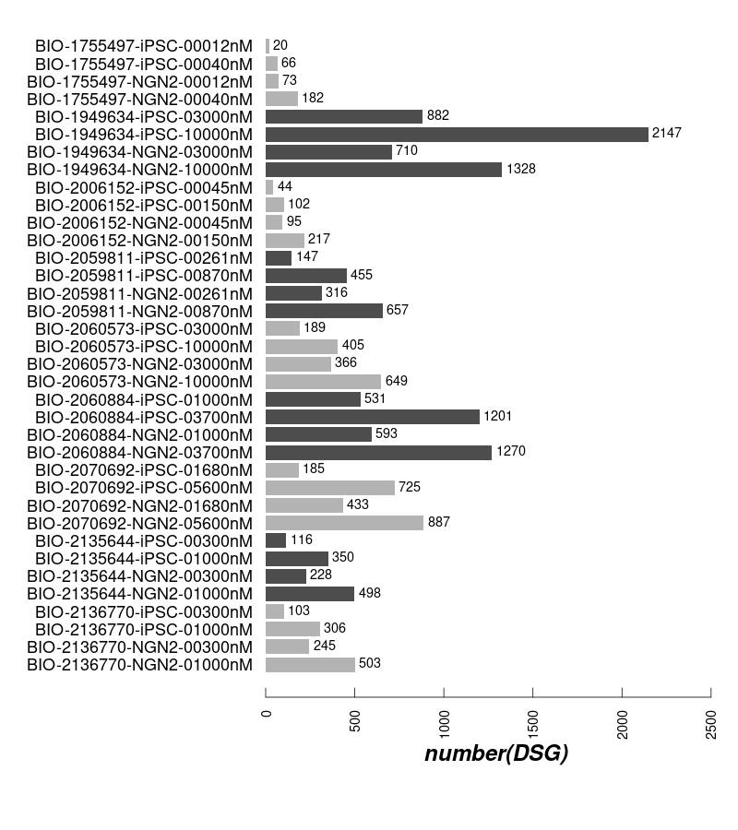
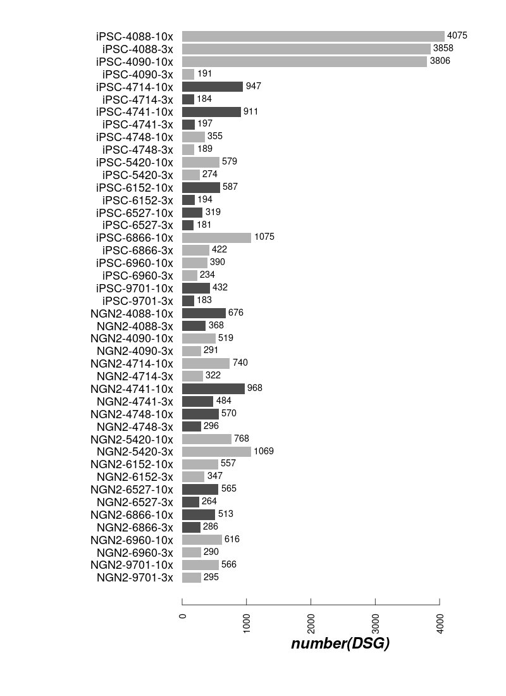
DSG: 1st batch and 2nd batch
1st batch
2nd batch with R4
2nd batch WO R4

Slide 12
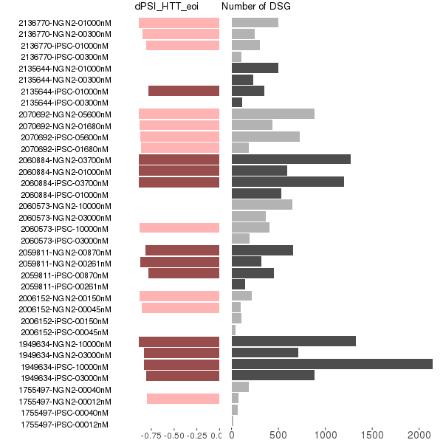
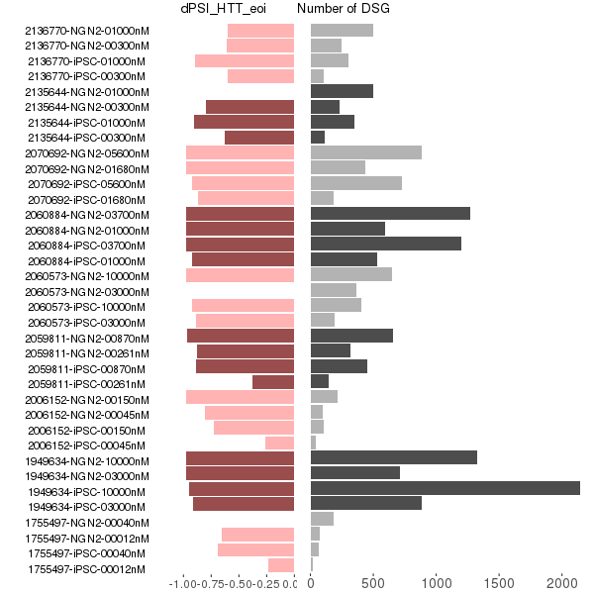
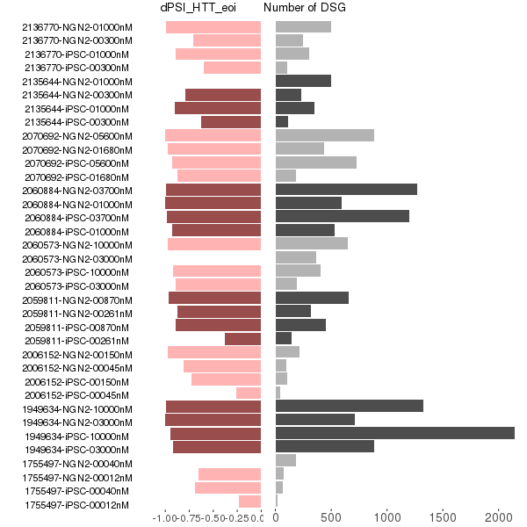
DSG and dPSI in eoi (1st batch)
Updated dPSI from leafcutter
dPSI from majiq
leafcutter majiq merged

Slide 13
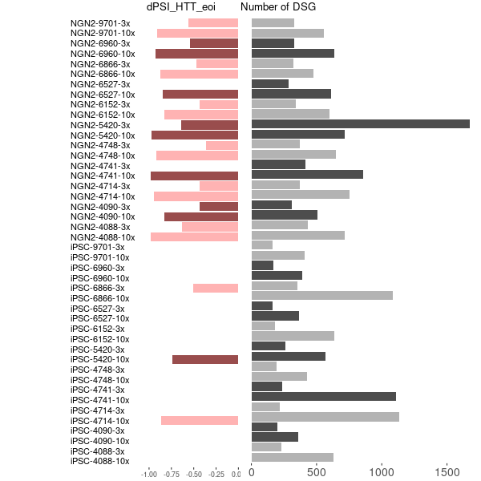
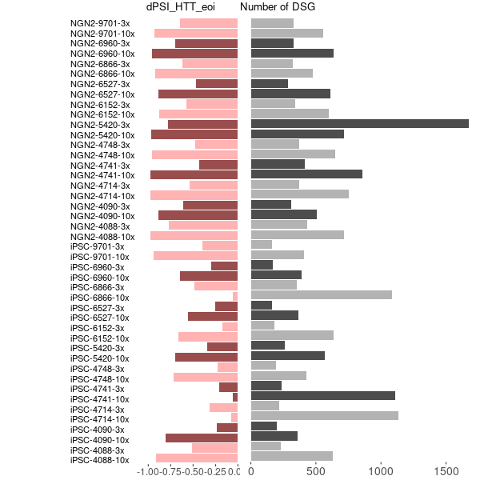
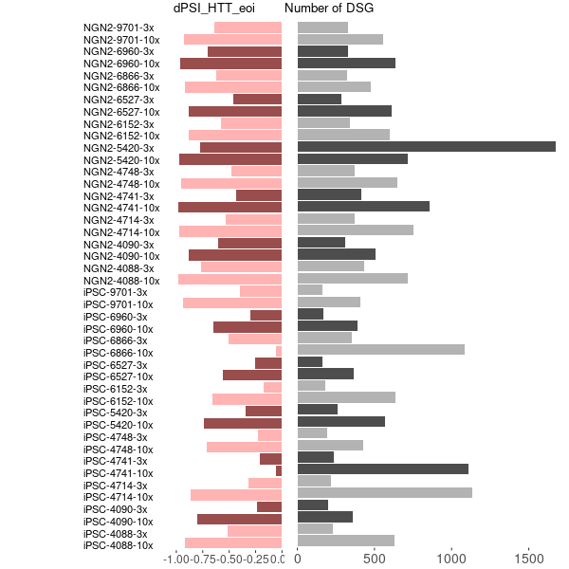
DSG and dPSI(2nd batch-No-R4)
Updated dPSI from leafcutter
dPSI from majiq
leafcutter majiq merged

Slide 14
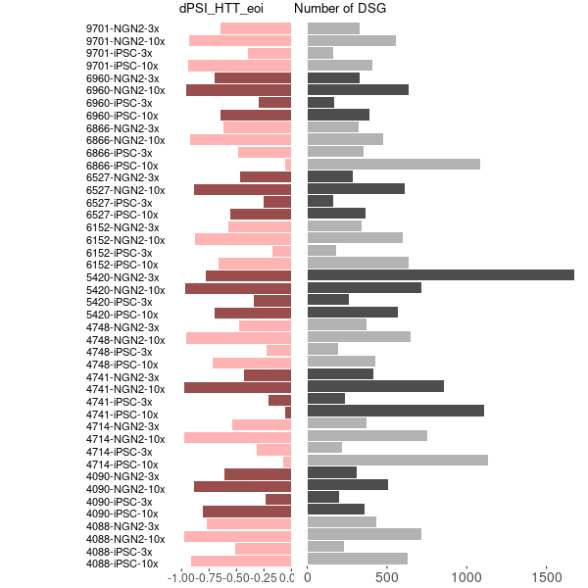
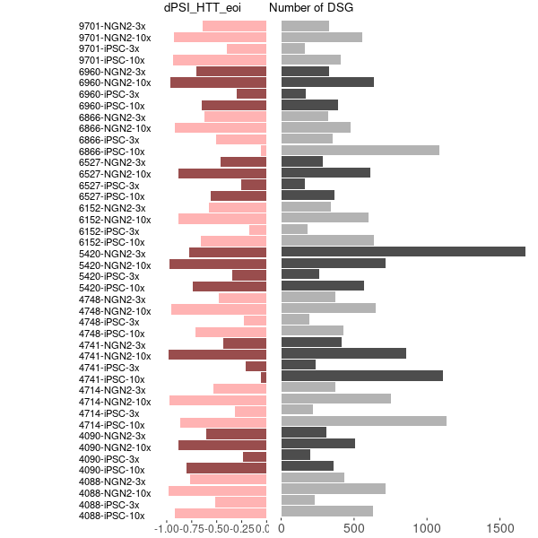
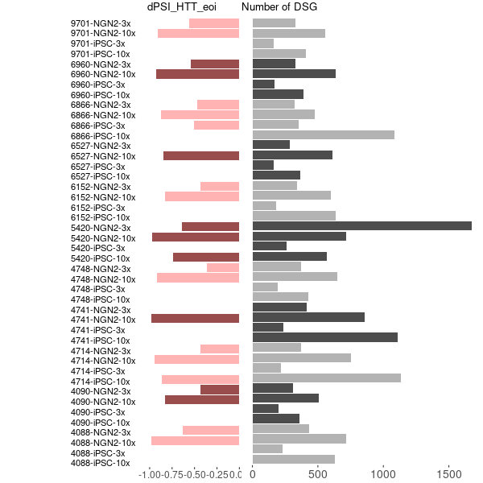
DSG and dPSI(2nd batch-No-R4)
Updated dPSI from leafcutter
dPSI from majiq
leafcutter majiq merged

Slide 15
Sample similarity from Gene Expression
Expression heatmap for iPSC
Expression heatmap for NGN2

Slide 16
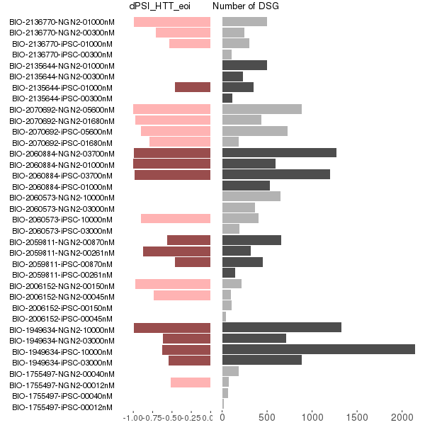
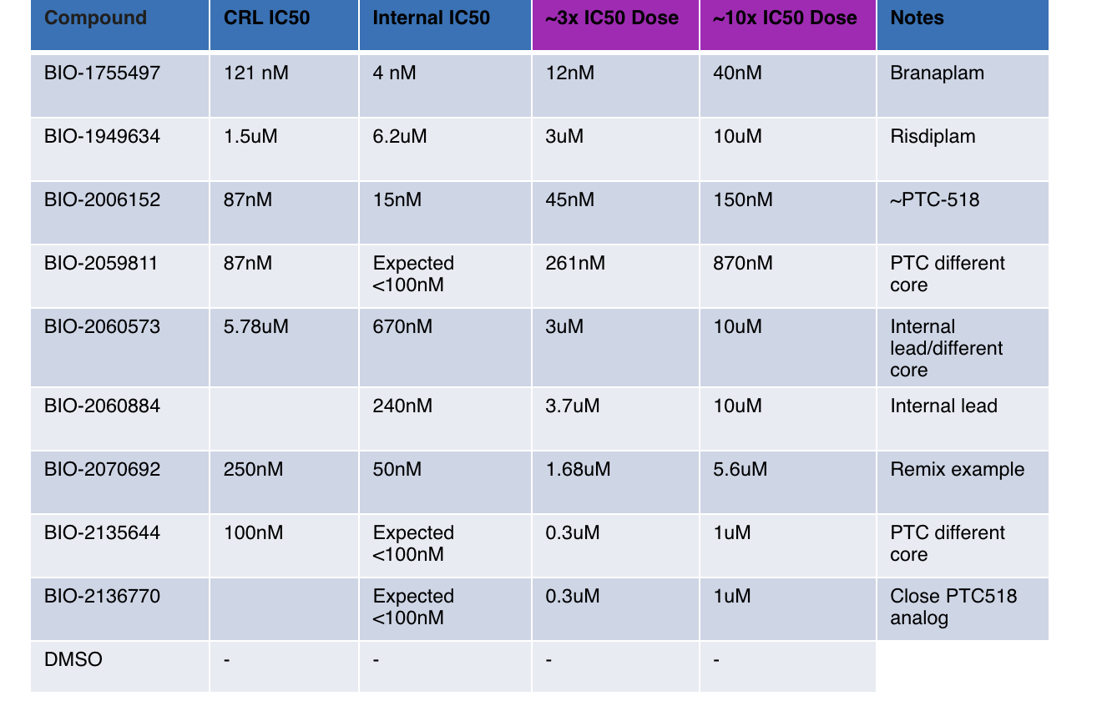
DSG and dPSI in eoi

